Slide 1
A Sales Reporting Application
Group 4

Slide 2
Requirement
Build a sales reporting application for the management of a store with multiple departments.
Users should be able to select a specific department they are interested in.
Upon selecting a department, two types of reports are to be displayed:
Monthly report - A list of all transactions for the current month for the selected department.
YTD sales chart - A chart showing the year-to-date sales for the selected department by month
Whenever a different department is selected, both of the reports should be refreshed with the data for the currently selected department.

Slide 3
Actor
User

Slide 4
Use Case Diagram
Sales Reporting App
User
Select Department
<<include>>
<<include>>
Display Monthly Report
Display YTD Chart

Slide 5
Select Department [UC1]
Requirements : R2
Description : Users can select a department of a store
Actor : User
Basic Flow [BF1] :
A store lists all departments for the user to select.
The user selects a department.
Include [UC2], the system displays Monthly Report of the selected department.
Include [UC3], the system displays YTD Chart of the selected department.
Alternate Flow
The selected department is invalid, back to [BF1.1]

Slide 6
Display Monthly Report [UC2]
Requirements: R3
Description: After a department is selected by User, the system displays the monthly report.
Actor: None
Basic Flow [BF2]
The system receives which department User selects.
By the current month and the selected department, the system loads the transaction data from the database.
The system displays the transactions in the form of a list.
Alternative Flow [AF2]
3.1. When the data format is wrong, display an error message.

Slide 7
Display YTD Chart [UC3]
Requirements : R3
Description : Display a chart showing the year-to-date sales for the selected department by month
Actor : None
Basic Flow : [BF3]
Get the data from database
Generate the chart
Display the chart
Alternative Flow [AF3]:
Invalid Data, back to [BF1.1]

Slide 8
Scenario
Scenario ID | Description | Flow | Ending State
S1 | reports normally displayed | BF1 BF2 BF3 | end
S2 | fail to select department | BF1 AF1 | end
S3 | fail to display Monthly Report | BF1 BF2 AF2 | end
S4 | fail to display YTD chart | BF1 BF2 BF3 AF3 | end

Slide 9
Test Cases
Scenario | Department | Available monthly transaction data | Available YTD transaction data | Expected Result
S1 | Valid | Valid | Valid | Successfully display Monthly Report and YTD Chart
S2 | Invalid | - | - | Error Message shows Invalid Department.
S3 | Valid | Invalid | - | Error Message shows Invalid transaction data.
S4 | Valid | Valid | Invalid | Error Message shows Invalid transaction data.

Slide 10
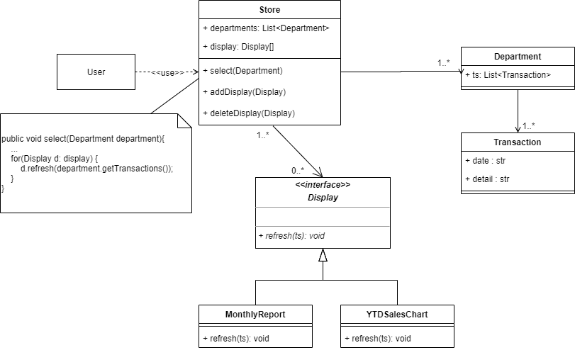
Class Diagram

